Slide 1
Build a Serverless Web Application
Week 13

Slide 2
Authentication and Authorization
Authentication Are you who you say you are?
Authorization What are you permitted to do?

Slide 3
Authentication I recognize you
AuthN means identifying that something is what it is declared to be.
The thing being identified is often referred to as the "subject".
The most common form of AuthN today is password authentication or better yet two factor and tokens.

Slide 4
Authorization I recognize your authority
AuthZ answers the question "is this operation allowed?"
There are a lot of models for answering this question, some of them are based on Role Based Access Control, or RBAC.
RBAC means that a subject has a specific role, and a role has a set of permissions associated with it.
In the relational world, subjects and roles are a many-to-many relationship: there can be many roles for each subject and each role can have many subjects.

Slide 5

What can each person do?
7 people 5 tasks
Alice and Charles have 5 tasks they need to do
Betty and Dan have a single job
Zeke and Freddie are kind of similar
As are Freddie and Gomez
18 different entries
5 different job roles
 | Update Contact Info | Update Salary | Review Emp Data | Terminate Employee | Enter Yearly Review
Alice | X | X | X | X | X
Betty | X
Charles | X | X | X | X | X
Dan | X
Ezekial | X |  | X
Freddie | X |  | X |  | X
Gomez |  |  |  |  | X

Slide 6
What if Dan gets promoted
And Alice gets demoted
We remove four attributes from Alice
We add four new attributes to Dan
Lots of manual work
 | Update Contact Info | Update Salary | Review Emp Data | Terminate Employee | Enter Yearly Review
Alice |  |  |  |  | X
Betty | X
Charles | X | X | X | X | X
Dan | X | X | X | X | X
Ezekial | X |  | X
Freddie | X |  | X |  | X
Gomez |  |  |  |  | X

Slide 7
What are the job duties
Reviewing the individuals in HR
We see there are 4 roles
A Basic User
A Super User
HR Admin
DataEntry
 | Update Contact Info | Update Salary | Review Emp Data | Terminate Employee | Enter Yearly Review
Alice | X | X | X | X | X
Betty | X
Charles | X | X | X | X | X
Dan | X
Ezekial | X |  | X
Freddie | X |  | X |  | X
Gomez |  |  |  |  | X

Slide 8
Role Based Access Control
 | Update Contact Info | Update Salary | Review Resumes | Terminate Employee | Enter Yearly Review
SuperUser | X | X | X | X | X
BasicUser | X
HRAdmin | X |  | X
DataEntry |  |  |  |  | X

Slide 9
What roles does each person have?
SuperUser Alice and Charles
BasicUser Betty and Dan
HRAdmin Zeke and Freddie
DataEntry Freddie and Gomez
 | BasicUser | SuperUser | HRAdmin | DataEntry
Alice |  | X
Betty | X
Charles |  | X
Dan | X
Ezekiel |  |  | X
Freddie |  |  | X | X
Gomez |  |  |  | X

Slide 10
What roles does each person have?
If Dan gets promoted
Add SuperUser and drop BasicUser
And Alice gets demoted
Add DataEntry and drop SuperUser
 | BasicUser | SuperUser | HRAdmin | DataEntry
Alice |  |  |  | X
Betty | X | X
Charles |  | X
Dan | X
Ezekiel |  |  | X
Freddie |  |  | X | X
Gomez |  |  |  | X

Slide 11
Logging and Reporting Who did what and when
The final goal of a good AuthZ framework is the ability to perform audits and to record when resources are successfully or unsuccessfully accessed. It's a lot easier to perform this logging when the identity information is known at the time of the decision.

Slide 12
Amazon Cognito
Provides authentication, authorization, and user management.
Sign in directly with a user name and password, or
Through a 3rd party such as Facebook, Amazon, Google or Apple.
The two main components of Amazon Cognito are
User pools: User directories that provide sign-up and sign-in options.
Identity pools: Grant your users access to other AWS services.
You can use identity pools and user pools separately or together.

Slide 13
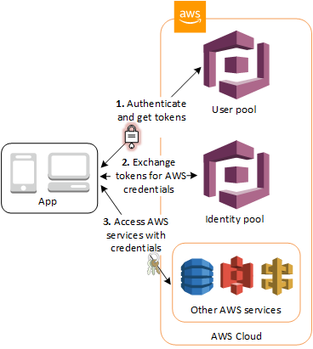
User and Identity pools Used together
First, User signs in through a user pool and receives user pool tokens after a successful authentication.
Next, App exchanges the user pool tokens for AWS credentials through an identity pool.
Finally, User can then use those AWS credentials to access other AWS services such as Amazon S3 or DynamoDB.

Slide 14
Review AJAX

Slide 15
Build a Serverless Web Application
The tutorial
https://aws.amazon.com/getting-started/hands-on/build-serverless-web-app-lambda-apigateway-s3-dynamodb-cognito/?refid=ha_a134p000007bsalaa0~ha_awssm-9610_pac&trkcampaign=psc_core-infra_storage_s3-features-multi-region-access-pts
The Code
https://unt.instructure.com/courses/62298/files/14985706?wrap=1
The GitHub repo in the tutorial is broken

Slide 16
Build a Serverless Web Application
Overview: Uber but for Unicorns!!
Application Architecture
AWS Lambda Controller – Performs the desired task
Amazon API Gateway Controller – Associates task with a request
Amazon DynamoDB Model – Persists our data
AWS IAM Roles – Work a function can do
Amazon Cognito Users - AuthN/AuthZ
AWS Amplify Console View – manages visible components

Slide 17
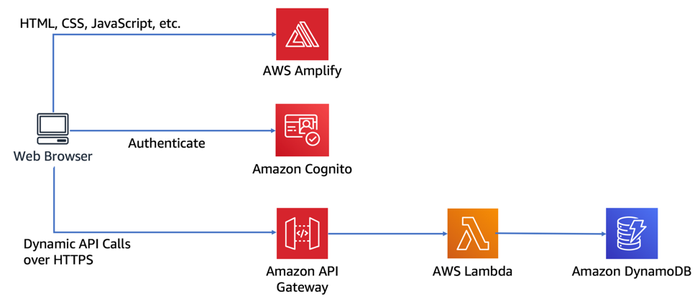
Architecture

Slide 18
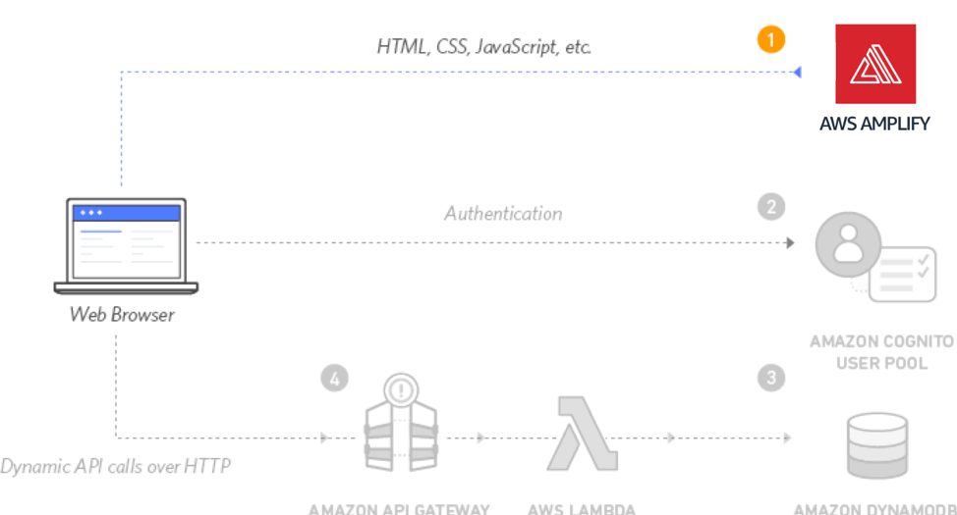
Module 1: Host a Static Web Site

Slide 19
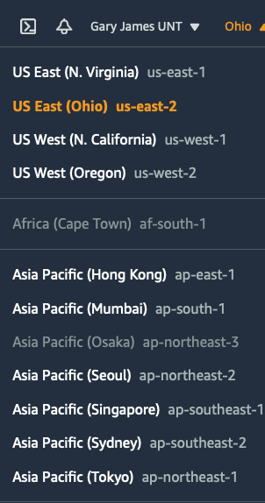
Static Web Hosting with Continuous Deployment
Unzip Wild Rydes and save to your project folder
Select Region
Create a git repo
Clone the code from the assignment
This did not work for me. Use the Zip file provided in the assignment
Commit and push code to your own GitHub repo

Slide 20
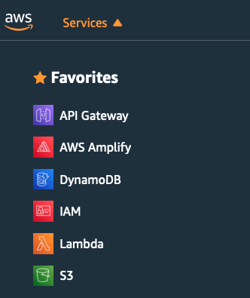
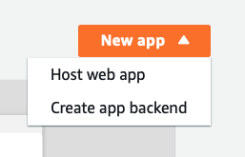
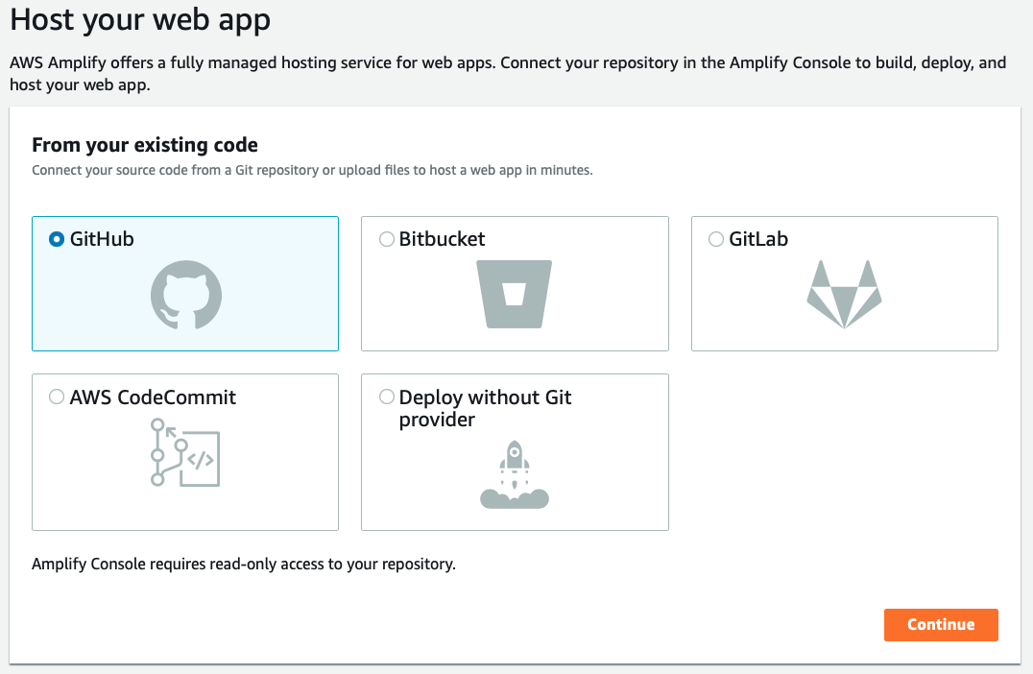
AWS Amplify Create Web App
Go to the AWS Amplify tab
Click New app
Host web app
Select the source – GitHub
Click Continue

Slide 21
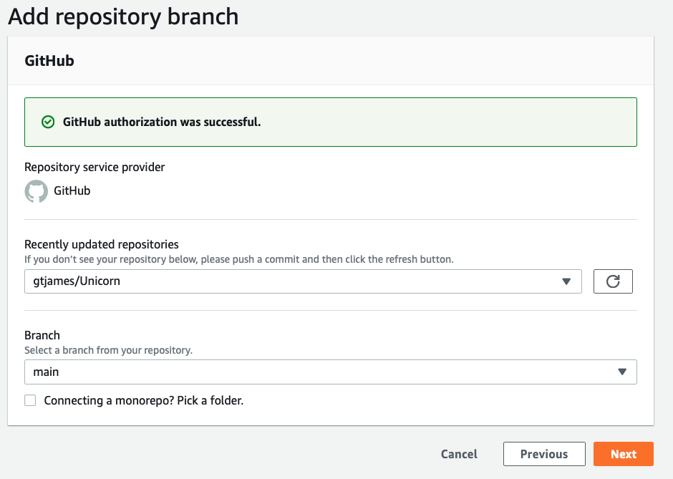
Add repository branch
GitHub should already recognize you
Set the repo to be used
Branch will be main (or master)
Click Next

Slide 22
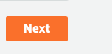
Configure build settings
Just click Next

Slide 23
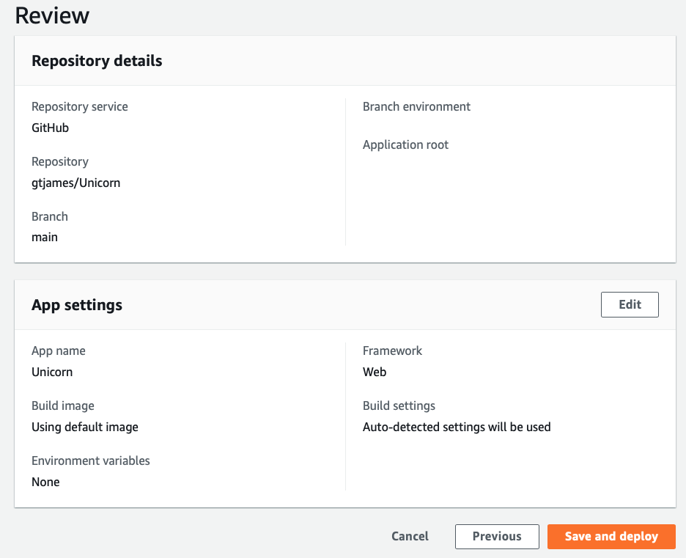
Review and Deploy

Slide 24
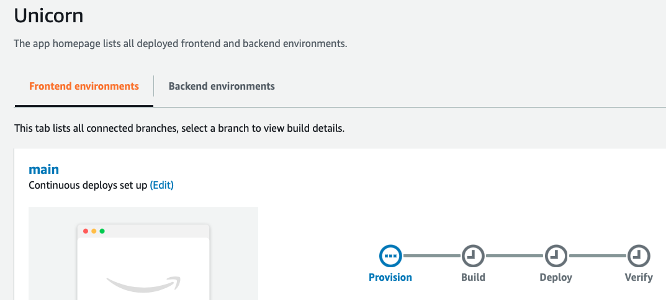
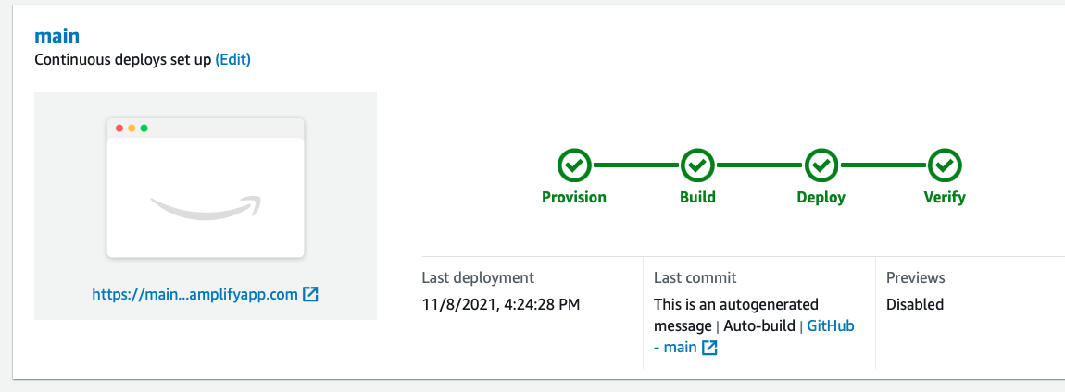
Be patient
Link is now active
Give it a click!
https://main.d3dyqni5rwsl5g.amplifyapp.com

Slide 25
Recap
In this module, you've created static website which will be the base for our Wild Rydes business.
AWS Amplify Console makes it easy to deploy static websites following a continuous integration and delivery model.
It has capabilities for "building" more complicated JavaScript framework-based applications and has features such as feature branch deployments, easy custom domain setup, instant deployments, and password protection.

Slide 26
Module 2: User Management Overview
In this module you'll create an Amazon Cognito user pool to manage your users' accounts. You'll deploy pages that enable customers to register as a new user, verify their email address, and sign into the site.
User Registration
Email confirmation
User Sign in

Slide 27
Cognito
Provides authentication, authorization, and user management for your web and mobile apps. Your users can sign in directly with a username and password, or through a third party such as Facebook, Amazon, Google or Apple.
Amazon Cognito Components
User pools are user directories that provide sign-up and sign-in options for your app users.
Identity pools enable you to grant your users access to other AWS services.
You can use identity pools and user pools separately or together.

Slide 28
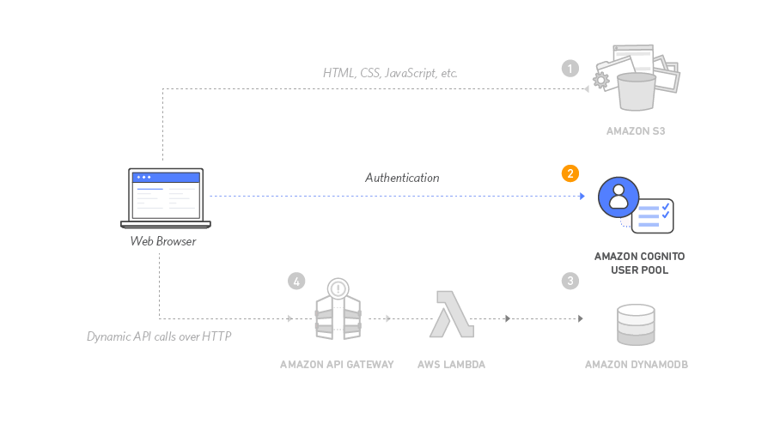
Architecture

Slide 29
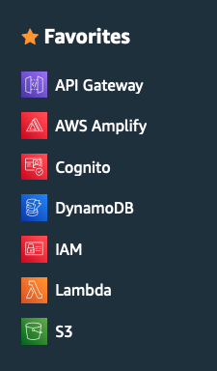

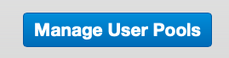
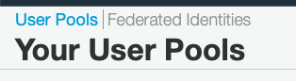
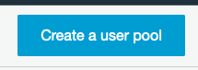
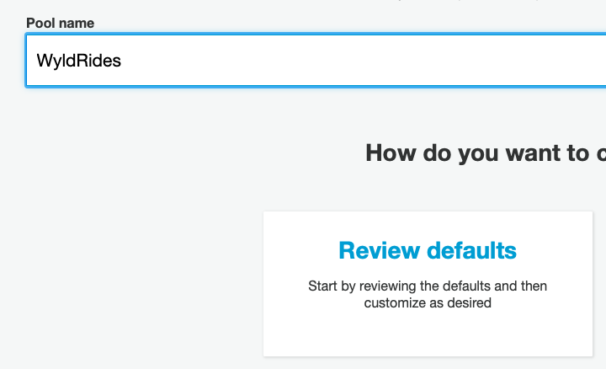
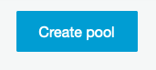
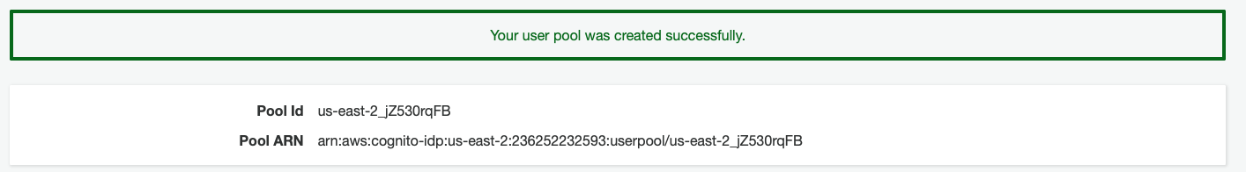
Create a Cognito User Pool
Go to Cognito
Manage User Pools
Create a user pool
Review Defaults
Review review review…
Create pool
Pool Id: us-east-2_jZ530rqFB

Slide 30
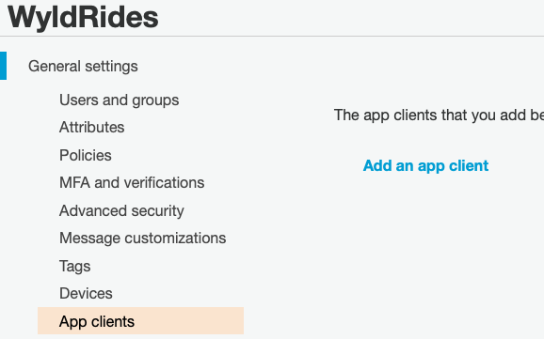
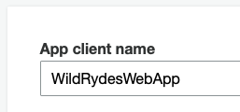
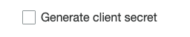
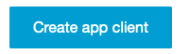
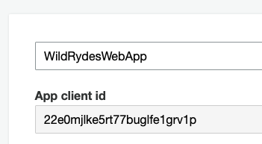
Add an App to Your User Pool
Add an app client
App client name WildRydesWebApp (no secrets)
Create app client
App client id 22e0mjlke5rt77buglfe1grv1p

Slide 31
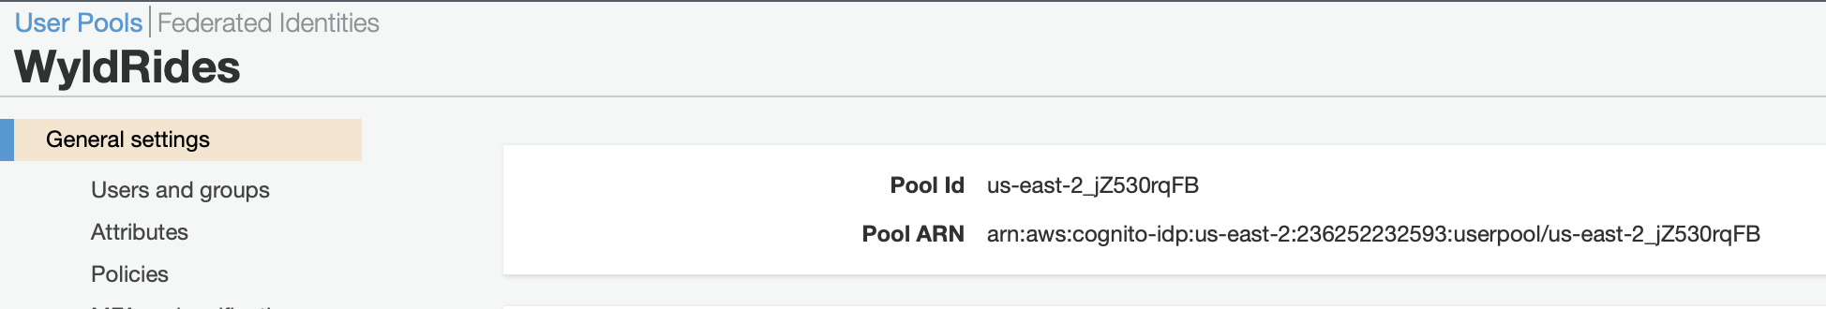
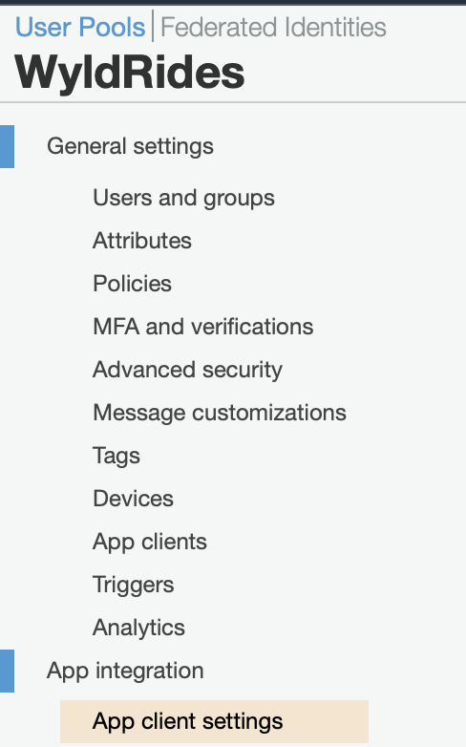
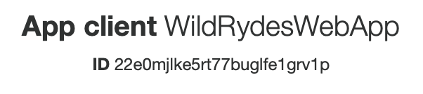
Update config.js
You will need the Pool id and the App client ID
See navigation below to find them

Slide 32
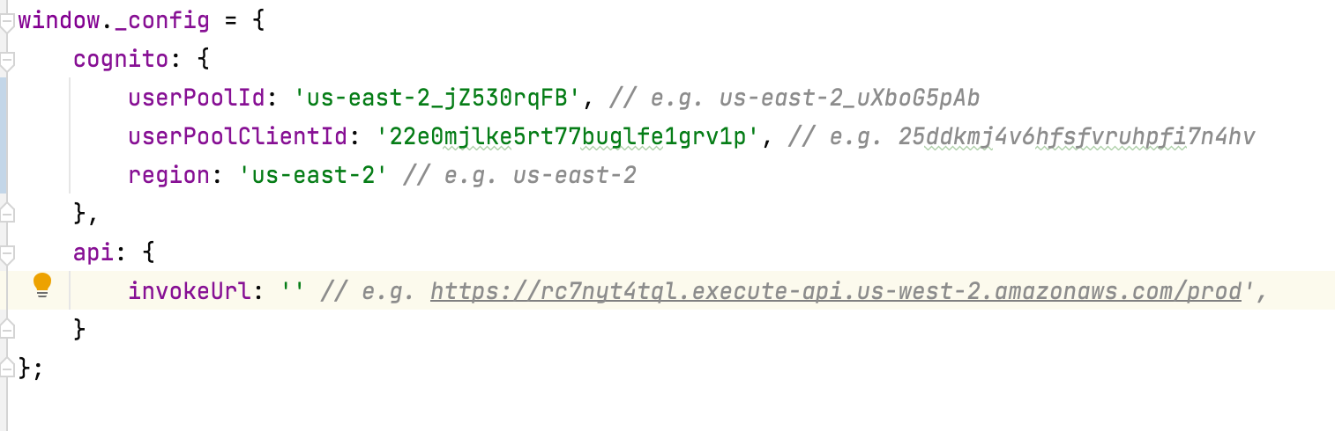
Update config.js
The Cognito block provides the connection information to our Cognito service on AWS

Slide 33
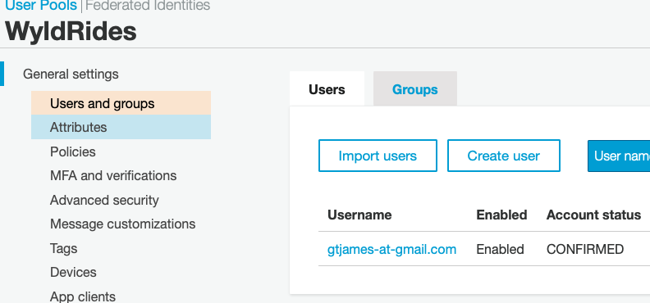
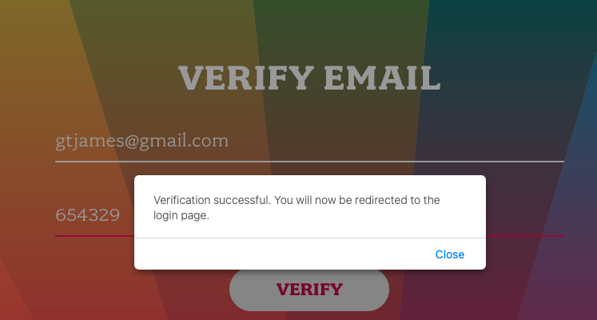
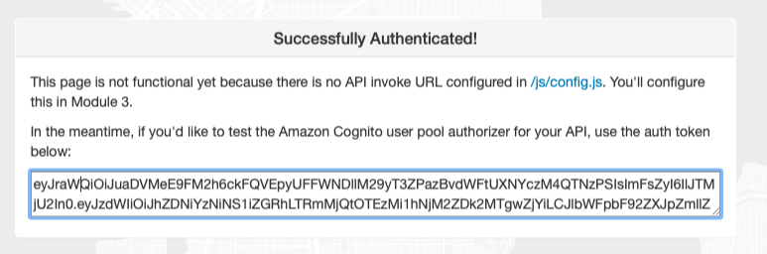
Validate your implementation

Slide 34
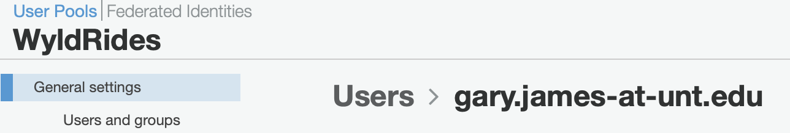
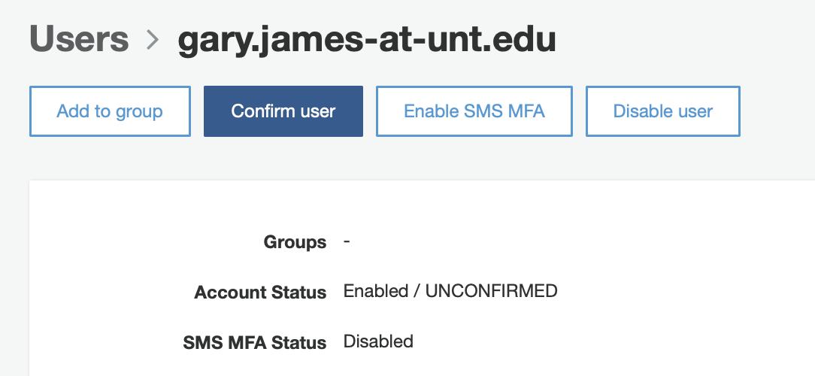
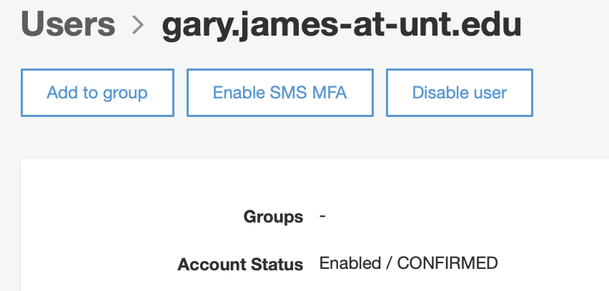
Validate your implementation
Confirm the user manually

Slide 35
Start HERE Module 3: Serverless Service Backend
Overview
In this module you'll use AWS Lambda and Amazon DynamoDB to build a backend process for handling requests for your web application. The browser application that you deployed in the first module allows users to request that a unicorn be sent to a location of their choice. In order to fulfill those requests, the JavaScript running in the browser will need to invoke a service running in the cloud.

Slide 36
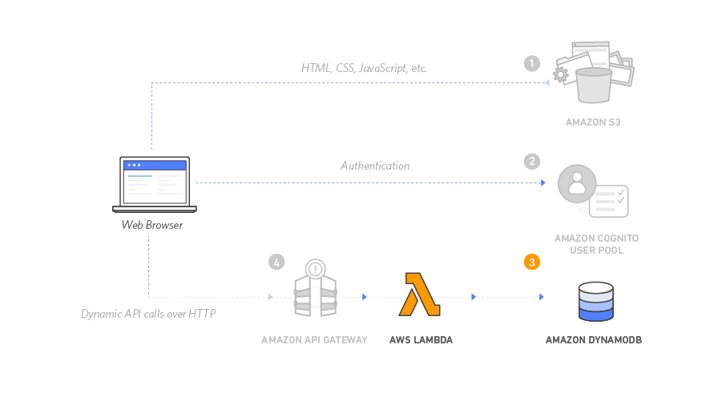
Architecture

Slide 37
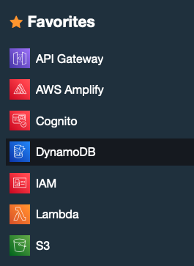
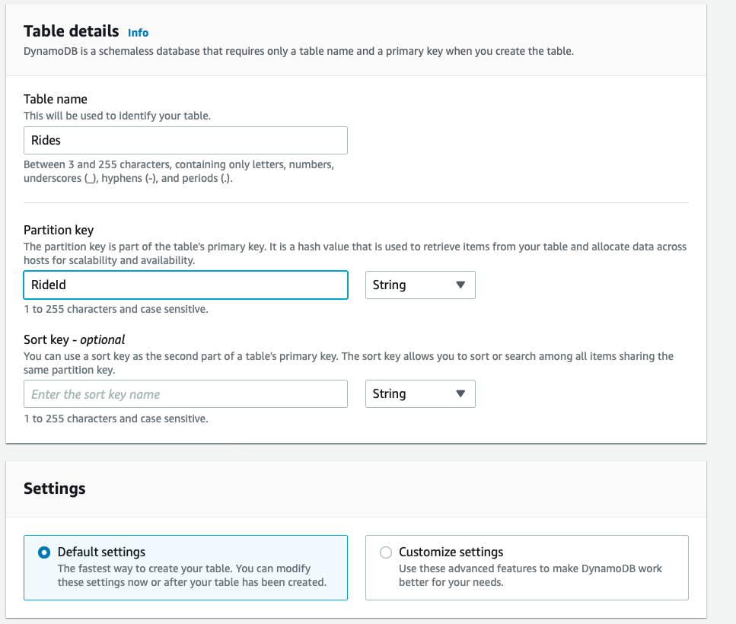
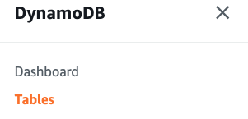
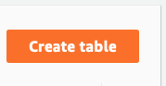
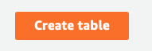
Create a DynamoDB table

Slide 38
Create an IAM Role for your Lambda function
Every Lambda function has an IAM role associated with it. This role defines what other AWS services the function is allowed to interact with. For the purposes of this workshop, you'll need to create an IAM role that grants your Lambda function permission to write logs to Amazon CloudWatch Logs and access to write items to your DynamoDB table.

Slide 39
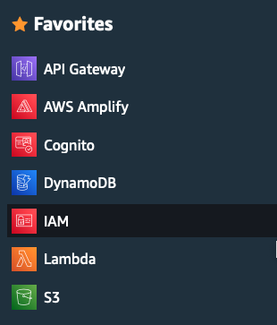
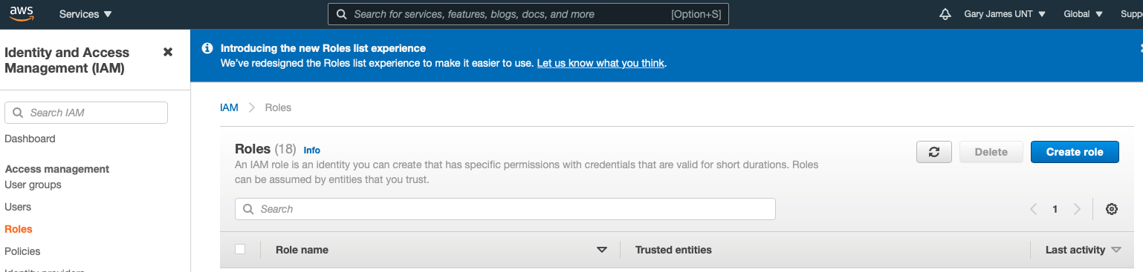
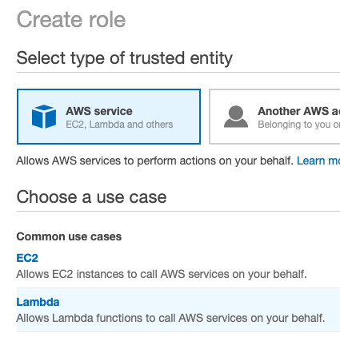
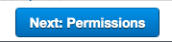
Create Role steps a-c

Slide 40
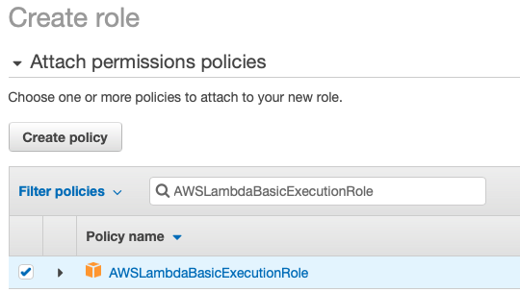
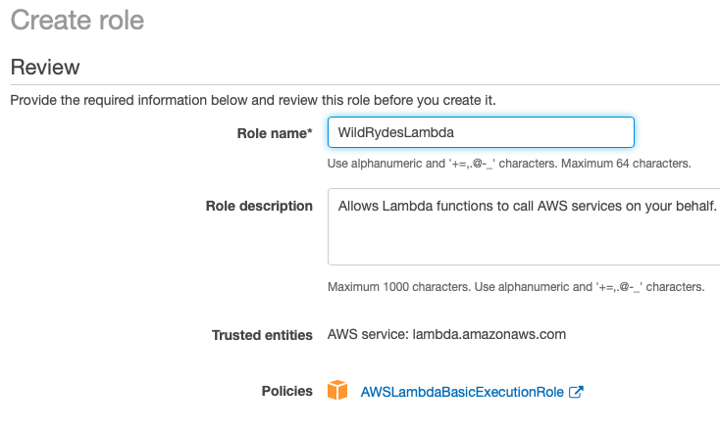
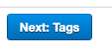
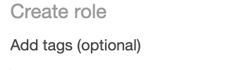
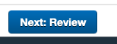

Create Role steps d-g

Slide 41



Create Role steps h-m

Slide 42




Create Role steps n-q

Slide 43


Create Role step q

Slide 44
Create a Lambda function for Handling Requests
AWS Lambda will run your code in response to events such as an HTTP request. In this step you'll build the core function that will process API requests from the web application to dispatch a unicorn.

Slide 45





Create Lambda function

Slide 46


Let’s look at this code

Slide 47



Validate Your Implementation

Slide 48
Look at the Lambda function
Exports.handler
Get the PickupLocation from the body
findUnicorn (gets a random unicorn)
recordRide
Returns unicorn, ETA, and username

Slide 49
Look a Client-Side esri-map.js
Line 25 View object has the map location
Line 75 the click function to mark the map
Line 86 animation code for the unicorn

Slide 50
Look a Client-Side ride.js
Line 8 No token to the the signin page
Line 18 RequestUnicorn POST
PickupLocation is passed to the lambda function
Line 32 on success call completeRequest
Line 41 completeRequest
Line 48 Animate the arrival of the unicorn
Line 58 onDocReady set the handler for the request button

Slide 51
Look a Client-Side signin.html
Line 44 form id=“signinForm”

Slide 52
Look a Client-Side cognito-auth.js
Line 117 handleSignin
Redirects to the ride page
Line 157 handle verification
Redirects to signin page
Line 132 handle registration
Redirects to verify page
Line 112 event handler for signin button
Line 73 signin request to server

Slide 53
Look a Client-Side Config.js
window._config = { cognito: { userPoolId: 'us-east-2_jZ530rqFB', userPoolClientId: '22e0mjlke5rt77buglfe1grv1p', region: 'us-east-2' }, api: { invokeUrl: 'https://3stehybb7a.execute-api.us-east-2.amazonaws.com/prod' } };

Slide 54
Module 4: Deploy a RESTful API
Overview
In this module you'll use Amazon API Gateway to expose the Lambda function you built in the previous module as a RESTful API. This API will be accessible on the public Internet. It will be secured using the Amazon Cognito user pool you created in the previous module. Using this configuration you will then turn your statically hosted website into a dynamic web application by adding client-side JavaScript that makes AJAX calls to the exposed APIs.

Slide 55
Architecture

Slide 56





Create new REST API

Slide 57



Create a Cognito User Pools Authorizer
Amazon API Gateway can use the JWT tokens returned by Cognito User Pools to authenticate API calls. In this step you'll configure an authorizer for your API to use the user pool you created in Module 2.

Slide 58


Verify your authorizer configuration

Slide 59


Create a new resource and method steps a-f
Create a new resource called /ride within your API. Then create a POST method for that resource and configure it to use a Lambda proxy integration backed by the RequestUnicorn function you created in the first step of this module.

Slide 60




Create the method steps g-q

Slide 61



Deploy your API
https://3stehybb7a.execute-api.us-east-2.amazonaws.com/prod

Slide 62

Update website config
in config.js update the invokeUrl. Set the value to the Invoke URL.
https://3stehybb7a.execute-api.us-east-2.amazonaws.com/prod
Save to GitHub

Slide 63


Validate your implementation

